Slide 1
Program 1.
Extended Euclidean Algorithm

Slide 2
Euclidean Algorithm
If two non zero positive integers = m and n,
Then, Greatest Common Divisor gcd(m,n)=r,
Where r= largest of the common divisors of m and n.
Eg. Gcd(10,36)= 2

Slide 3
How to compute GCD
Rules:
a) gcd(a,0)=a;
b) gcd(a,b)=gcd(b,r);
where, r = remainder of a/b

Slide 4
ALGORITHM
For gcd(m,n)
1. If m < n, exchange m and n
2. If n = 0, return m, terminate; else step 3.
3. Divide m by n and let r be the remainder.
(0 ≤ r < n)
4. If r = 0, terminate; n is the answer.
5. Set m = n, n = r, and go back to step 3.

Slide 5
Extended Euclidean Algorithm
If m and n are any two non zero, positive integers then gcd(m, n) =d,
Where d is the smallest positive element of the set of linear combination of m, n
hence, am + bn = gcd(m, n) = d
Where (a, b ϵ Z)

Slide 6
ALGORITHM
//Input: Two positive integers m and n
//Output: Greatest common divisor d and two integers a and b, such that am + bn = d
Set a’ = b = 1, a = b’ = 0, c = m, d = n.
Let q, r be the quotient and remainder, respectively, of c divided by d. (We have c = qd + r, 0 ≤ r < d)
If r = 0, terminate; we have in this case am + bn = d as desired.
Set c = d, d = r,
t = a’, a’ = a, a = t – qa,
t = b’, b’ = b, b = t – qb, and go back to step 2.

Slide 7
Affine Cipher
In affine ciphers, the key used for encipherment
involves using both a multiplicative and additive
key.
Eg. Encryption process:
If, y= cipher text, x= plaintext
Then, y=(ax+b)mod 26
Where, b= additive key
a= multiplicative key

Slide 8
Continue: Affine cipher
Decryption process:
where

Slide 9
Program 2.
DES

Slide 10
DES (Data Encryption Standards)
Block cipher encrypts a block of 64-bits plain text and generates a block of 64-bits cipher text.
For Decryption take 64 bit cipher text and generate 64 bit plaintext
key
Plaintext, 64 bit
Cipher text 64 bit
Encryption

Slide 11
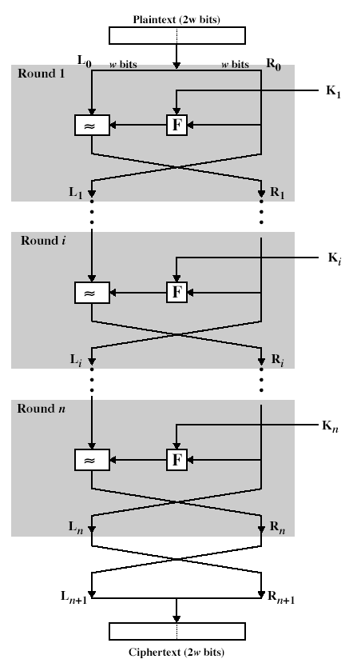
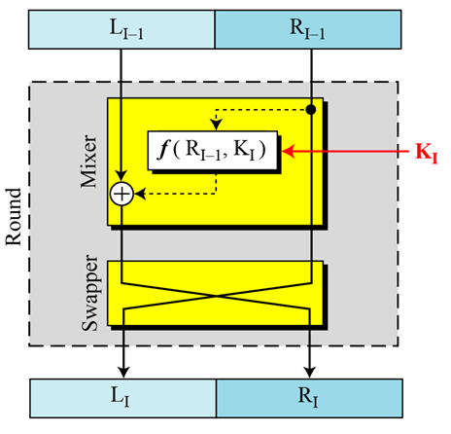
Feistel Cipher Structure

Slide 12
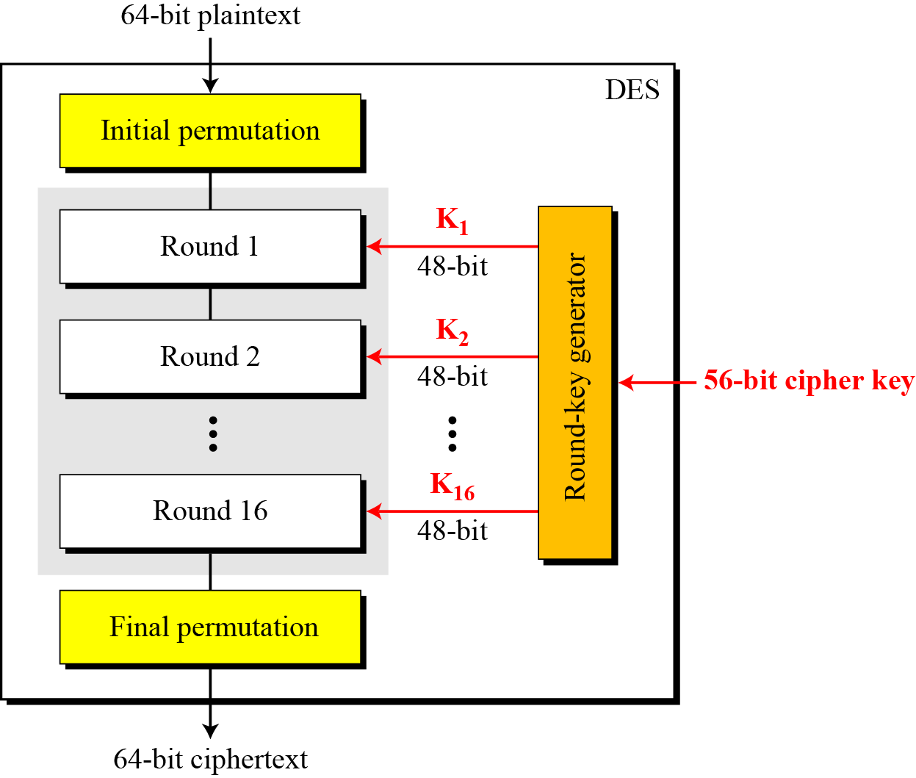
General Structures of DES

Slide 13
Details of each Steps
1. Initial and Final Permutations
2. Rounds
3. Key Schedule
4. DES Function
4.a)Expansion P-box
4.b) XOR operation
4.c)S-box operation
4.d) Straight P-box

Slide 14
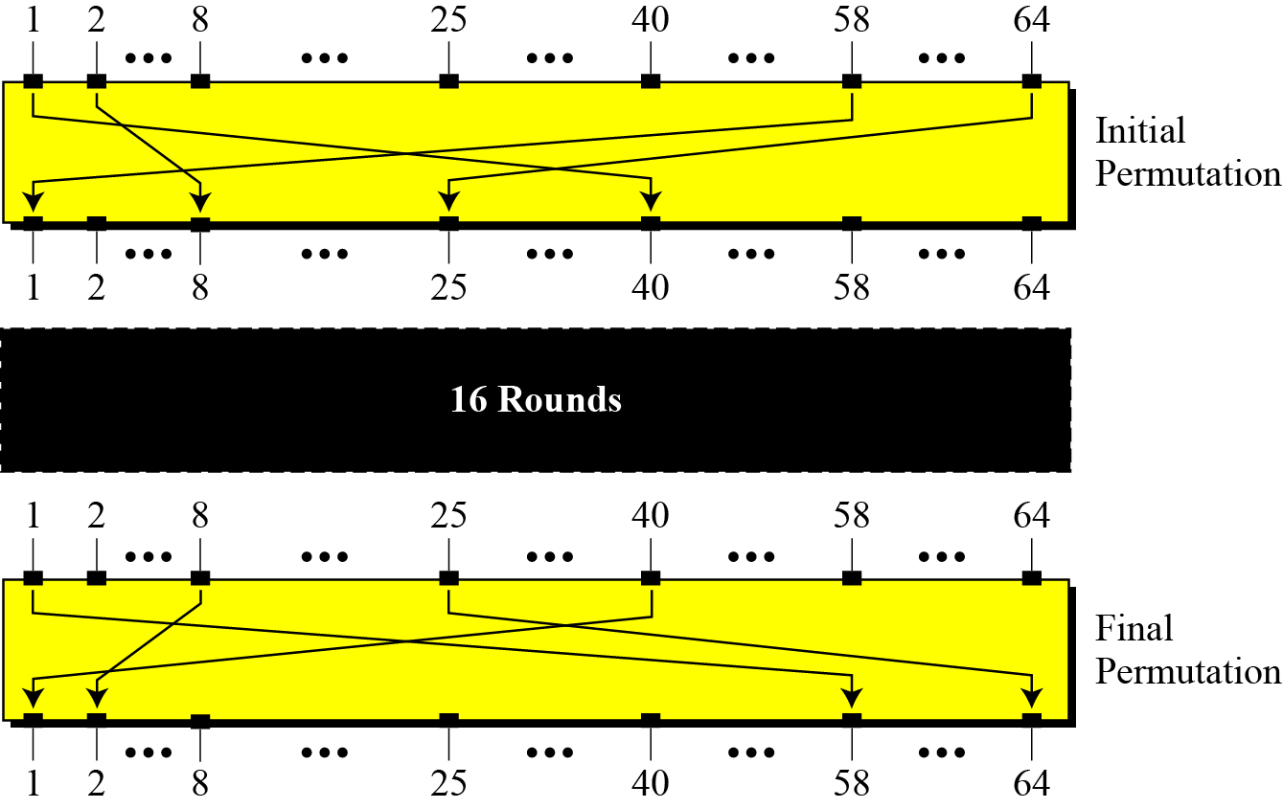
1.Initial and Final Permutations

Slide 15
Initial and final permutation tables
Each entry in the permutation table indicates the position of a numbered input bit in the output.

Slide 16
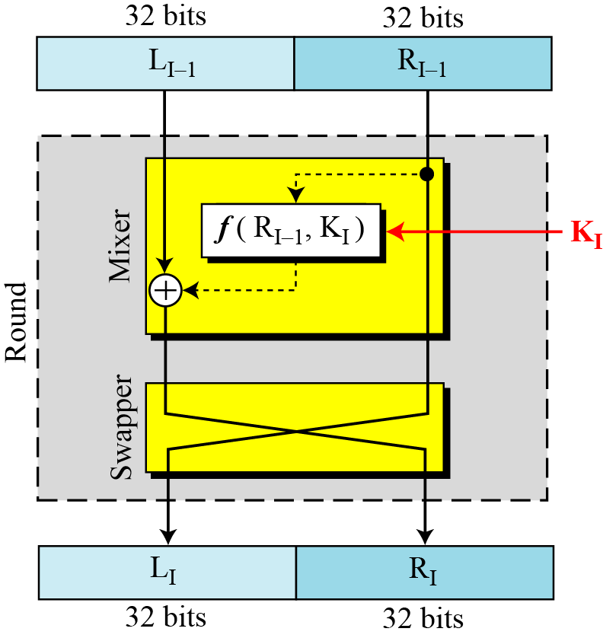
2.Rounds
DES has 16 rounds

Slide 17
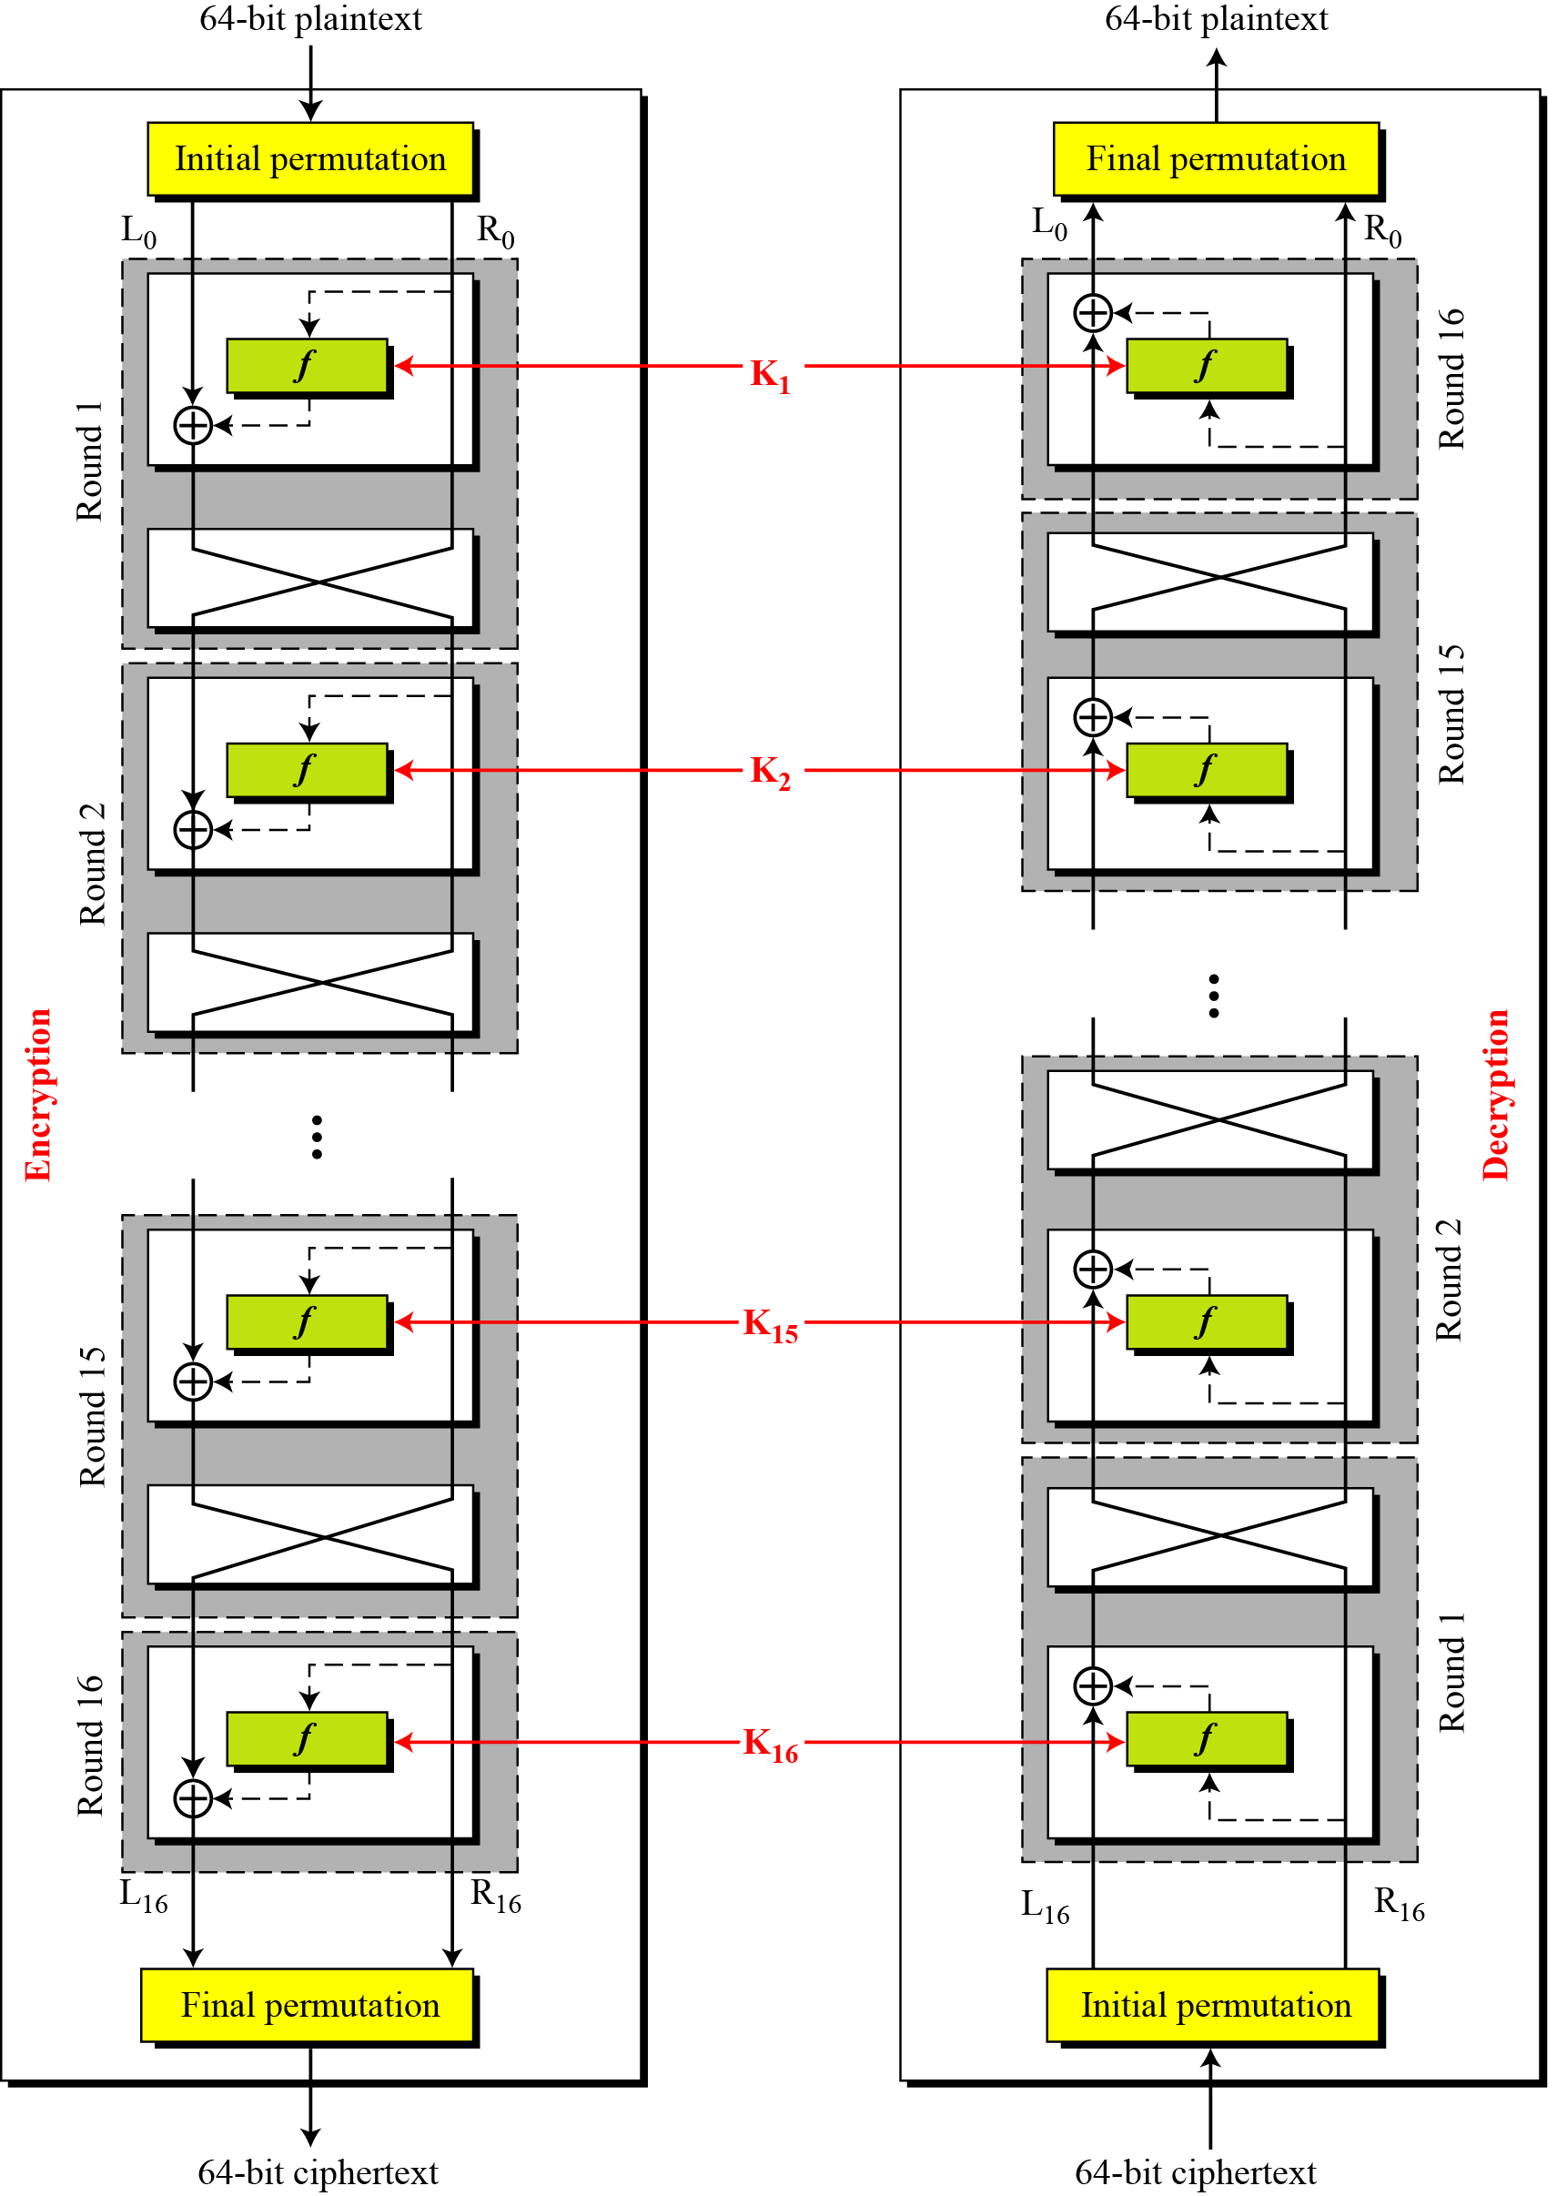

Slide 18
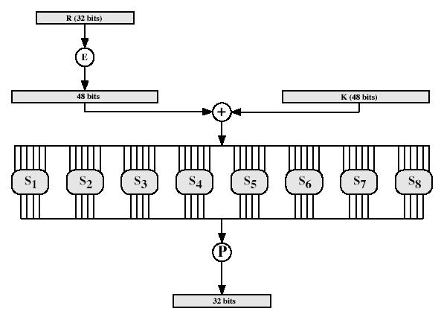
3. Key Schedule
The round-key generator creates sixteen 48-bit round keys from 56-bit cipher key. Which is then X-OR with 48 bit expanded value of right 32 bit in each round.

Slide 19
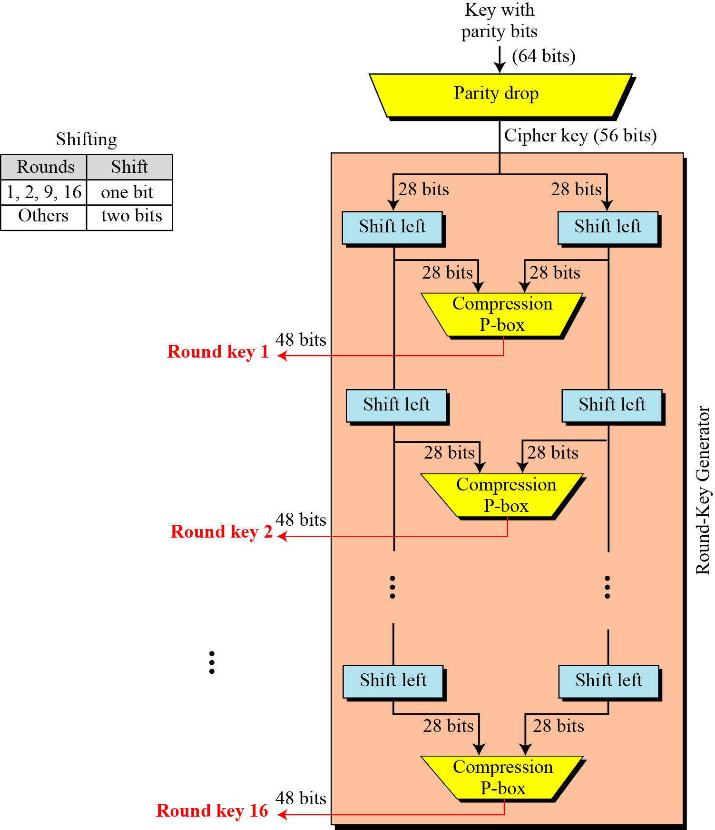

Slide 20
Key-compression table-48 bit key

Slide 21
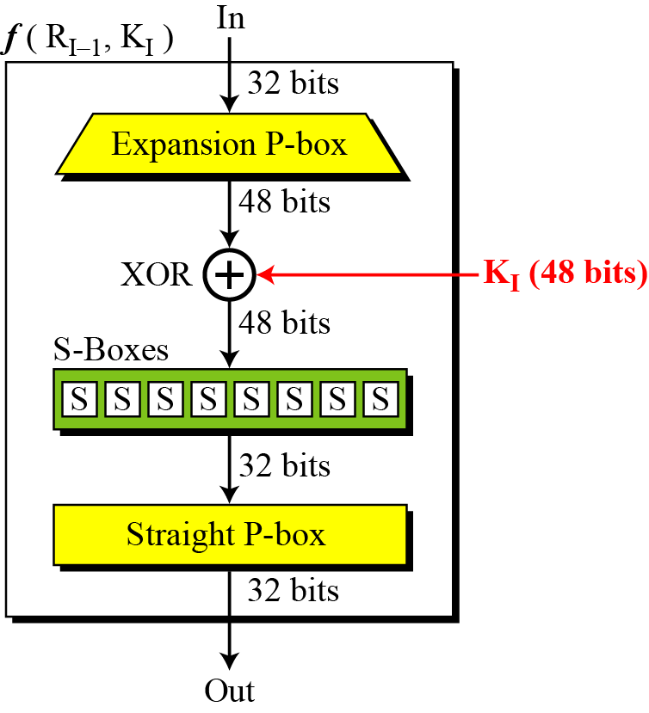
4. DES Function
The DES function applies a 48-bit key to the rightmost 32 bits to produce a 32-bit output.

Slide 22
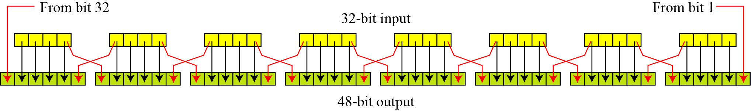
4.a) Expansion permutation

Slide 23
4.b) XOR-operation
After the expansion permutation, DES uses the XOR operation on the expanded right section and the round key. Note that both the right section and the key are 48-bits in length. Also note that the round key is used only in this operation.

Slide 24
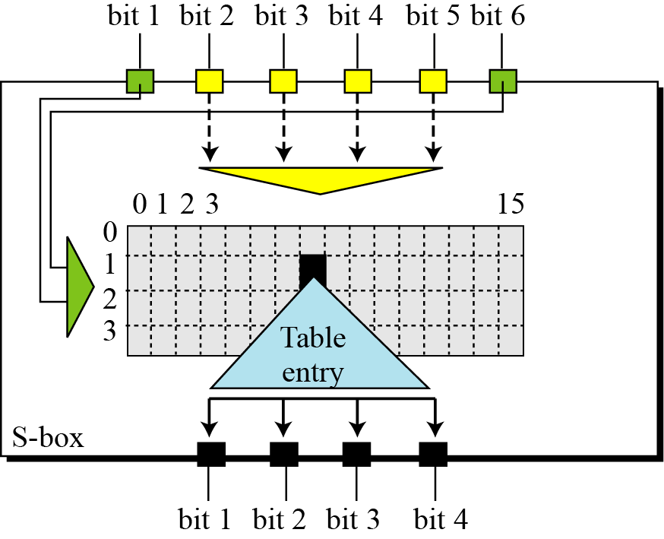
4.c)S-box

Slide 25
S box-1 table

Slide 26
4.d)Straight permutation table

Slide 27
Program 3.
AES

Slide 28
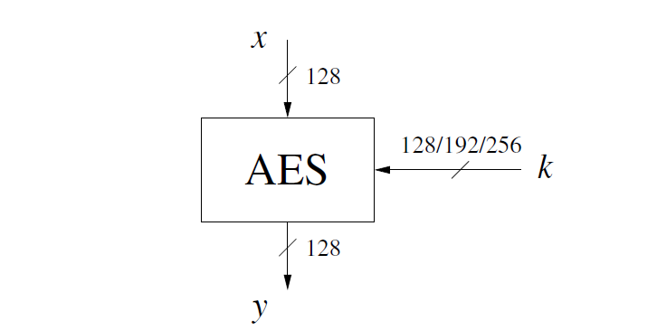
AES (Advance Encryption Standards)
Block cipher

Slide 29
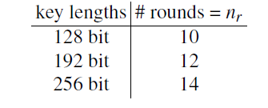
Key lengths and number of rounds for AES
Total number of Round Keys required = Nr+1

Slide 30
The internal Structure of AES Rounds is as follows
Byte substitution layer
Shift Row
Mix Column
Add round key

Slide 31
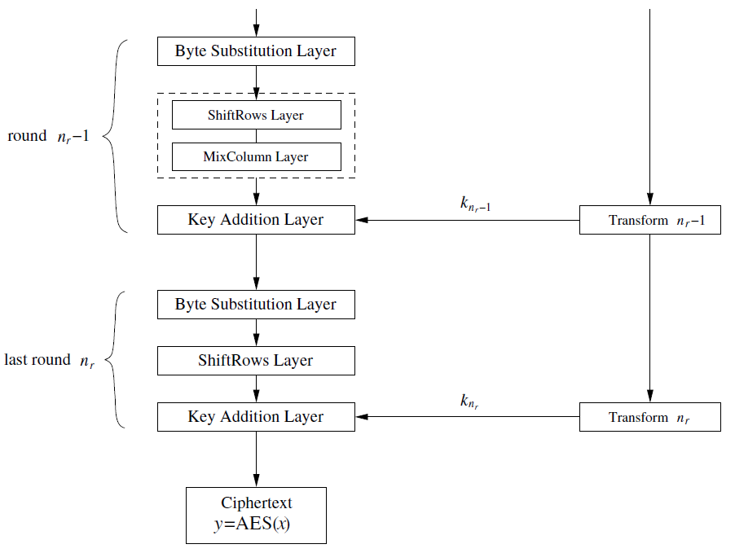
Continue…..

Slide 32
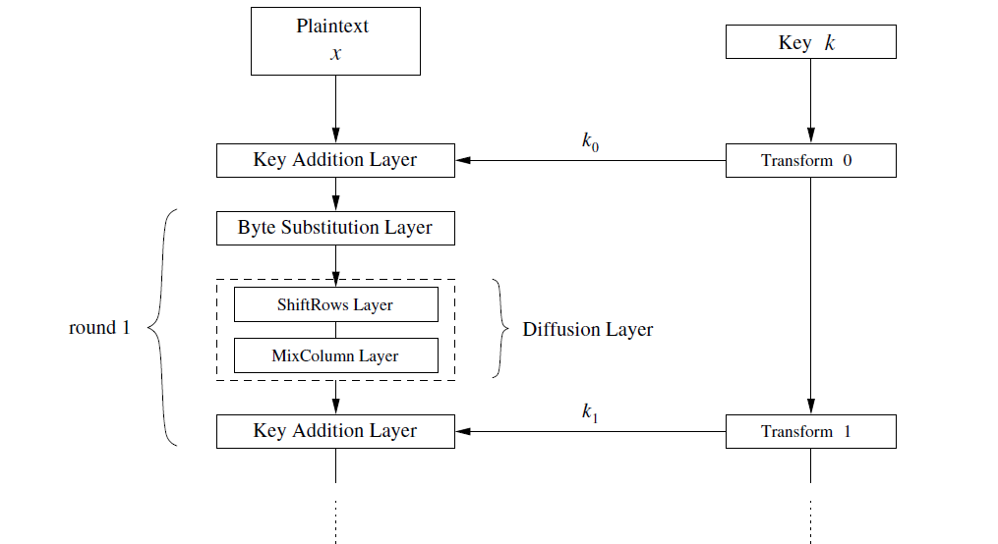
AES encryption block diagram

Slide 33
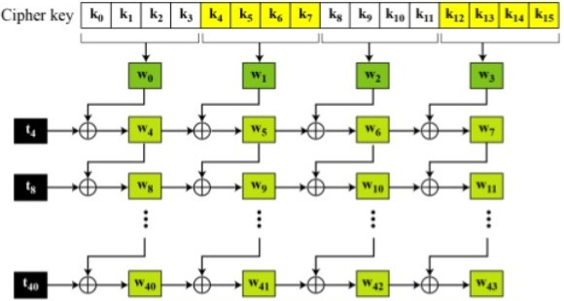
AES Round key generation for Key Addition Layer

Slide 34
Continue….
How to compute :

Slide 35
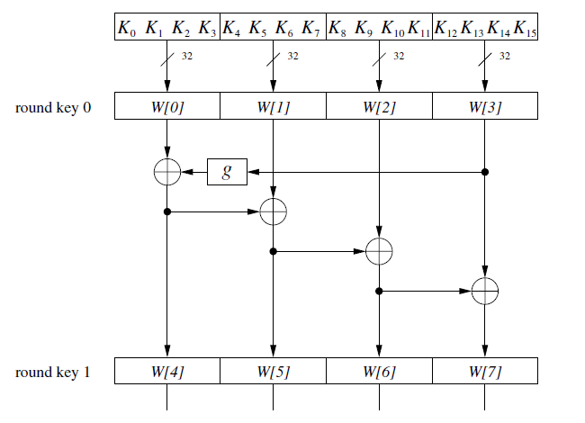
128 bit key size

Slide 36
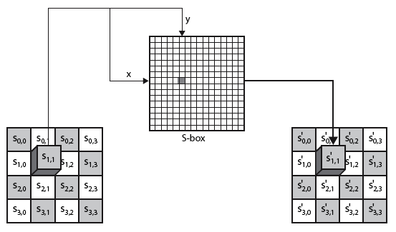
AES Rounds- 1. Byte Substitution Layer

Slide 37

Substitute Byte Example

Slide 38
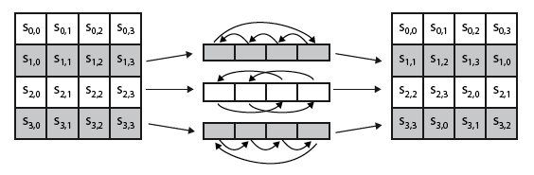
2.Shift Row

Slide 39

Shift Row Example

Slide 40
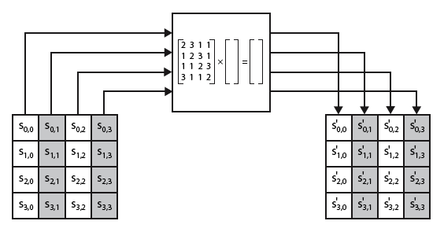
2.Mix Column
Multiply each column with a constant matrix and replace the column with new data bytes.

Slide 41


Mix column Example

Slide 42
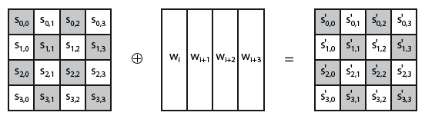
4. Add Round Key

Slide 43
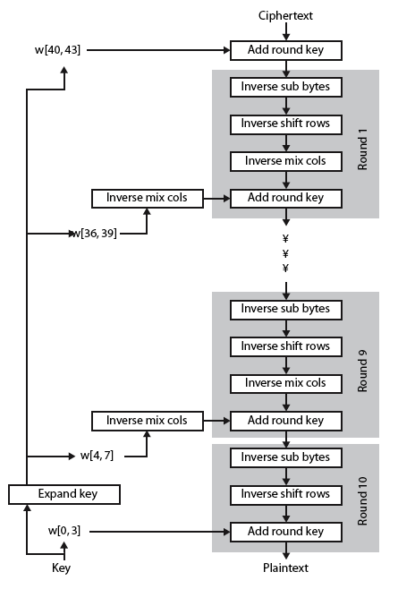
AES Decryption

Slide 44
Program 4.
RSA Algorithm

Slide 45
RSA is a Public key cryptosystem
Two type of key is used –
encryption key-
Receiver’s public key which is known to all
Decryption key-
Receiver's private key which is known only to the recipient of the message

Slide 46
RSA key generation algorithm
Select two large prime number p and q ranges between (512-1024 bits), where
Compute
3. And
4. Choose an integer e between such that
5. Compute or
Public key (e, n)
Private key (d)
Note: prime number p and q are kept secret and after key generation process complete both can be discard.

Slide 47
Encryption and Decryption
Plaintext
Encryption key
Decryption key
Cipher text
Encryption
Decryption

Slide 48
RSA Example
Select primes: p = 17 & q = 11
Compute n = p × q =17×11=187
Compute ø(n)=(p–1)(q-1)=16×10=160
Select e : gcd(e,160)=1; choose 1≤e<ø(n)=7
Determine d: de=1 mod 160 and d < 160 Value is d=23 since 23×7 = 161 mod 160 = 1
Publish public key e = {7,187}
Keep secret private key d = {23}

Slide 49
RSA example continue…
Alice wants to send a message p=4 to Bob
She will encrypt using public key of Bob as
Send 115 to Bob
Bob will decrypt this message by using his private key =23

Slide 50
Fast exponentiation algorithm

Slide 51
Program 5.
Diffie Helman Key Exchange

Slide 52
Algorithm
p and g are both publicly available numbers
p is at least 512 bits
Users pick private values a and b
Compute public values
x = gª mod p
y = g^{b} mod p
Public values x and y are exchanged
Compute shared, private key
k_{a} = yª mod p
k_{b} = x^{b} mod p

